Slide 1


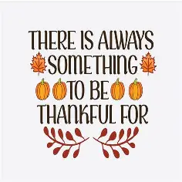

November 2025
BELLEVUE SENIOR
Community Center
Golden opportunities await a new day!
109 W. 22nd Ave. Bellevue, NE 68005 (402) 293-3041 Monday-Friday 8:00 am - 4:00pm
Hello People!
November is the time of the year when we take time to be thankful for all we have. Each day we can find something we have been blessed with. Take a moment to be happy with what you have.
We are so thankful for the support of the community, our board members, ENOA, our volunteers and YOU! Thank you for helping our fundraiser be so successful!
A special shout out to those who went above and beyond for the fundraiser. Although many may have helped with the baskets, Priscilla worked on each and every one! Jean made creative labels and worked at the fundraiser, Mary and James donated many baskets and worked with Priscilla selling tickets, Lore and Lucy worked Cal-cutta at the social and Lynne visited over 50 businesses bringing in thousands of dollars in gift cards!
Thanks to everyone for being part of
the fundraiser!
Cheers!
Kathy and Dawn
BOARD OF DIRECTORS
Jim Janicki
President
Lisa Summers-Benak
Vice President
Jamie Moore
Treasurer
Dorene Narofsky
Secretary
Ralph Gladbach
Voting Member
Mary Jo Hopfensperger
Voting Member
Shirley Tingley
Voting Member
Katie Herbert
Voting Member
Joyce Wells
Voting Member
IN THIS ISSUE:
Page 2:
Mark your Calendar
Page 3:
Fundraiser Update
Page 4:
November Birthdays
Pages 5:
Activity Calendar
Page 6:
Hot Lunches
Page 7:
Deli Lunches
CENTER STAFF
Kathy Van Den Top, ENOA, Manager
Dawn Jaixen
ENOA, Assistant Manager
Supported by the Eastern Nebraska Office on Aging
Partnerships with City of Bellevue and Bellevue Public Schools
www.bellevueseniorcommunitycenter.com

Slide 2
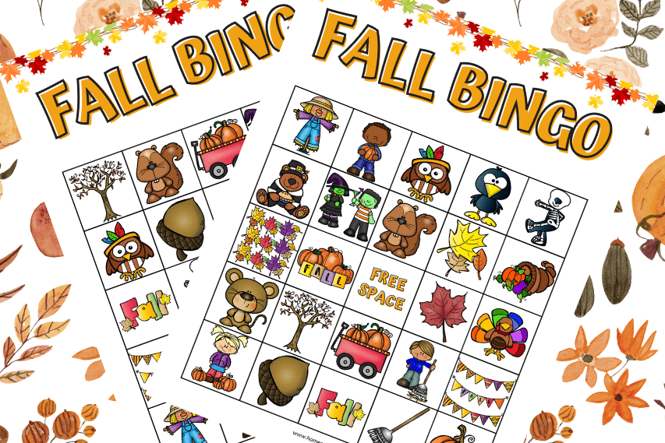
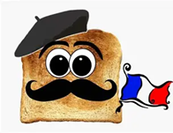

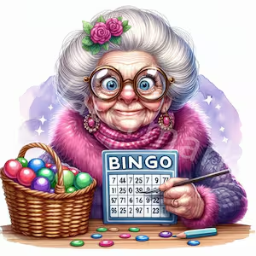
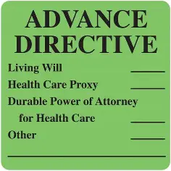


Page 2
Bellevue Senior Community Center News
November 2025
MARK YOUR CALENDAR!
HAY there! Do you want to have a really GOURD time? Join us for Fall Y’all Bingo on Wed. November 12th at 1:00pm. We don’t want to LEAF anyone out so be sure to sign up by Monday, Nov. 10th. We will have lots of fun and lots of prizes. Make a day of it and grab lunch before we start.
Bon Appetit! Have you tried our delicious French Toast Pizza? It’s a Cinnamon roll crust drizzled with maple cream cheese and fresh berries! Breakfast is served on Nov. 25th at 9:00 am. Breakfast with juice, and coffee for only $4.00.
Friends are the Family we chose! Celebrate and be thankful for the gift of friendship! We spend more time at the center than we do with our family! Join us in at a Friendsgiving Celebration on Friday, Nov. 21st at 10:30 with Dan Reynolds - Neil Diamond vocal impressionist! We will have delicious snacks. Save your seat by Wed. Nov. 19th.
Give your Family peace of mind. Lisa Summers-Benak will help guide you through the importance and difference of the types of Advance Directives. If you think it is difficult to talk about this with your kids, imagine how hard these decisions would be for them without you!
You MUST sign up in order to receive your free booklet. She will be here on Thursday, November 20th at 9:30 for her Bingo and this presentation will be at 10:30.
Our September winner was Mary Marshicillo !! She won $191.00 and so the center won $191.00 You can’t win if you don’t play!
PS –We will not be serving morning Panera snacks on party days and when we have our breakfast.

Slide 3


Page 3
Bellevue Senior Community Center News
November 2025
FUNDRAISER UPDATE
The final numbers are in ! This year we fell short of our goal, but we still had a successful day ! Lots of fun, food and a good time by all who attended! Please remember our sponsors when doing business!
$1000.00 Sponsors: Prairie Wealth Advisor with Paul Deitering, Hillcrest Health & Living and Bellevue Memorial Chapel
$500.00 Sponsors: Bellevue Volunteer Fire Dept. & Bellevue University
$250.00 Sponsors: Roth Self Storage, Erwins Jewelers & NP Dodge Real Estate – Maria Polinsky
$150.00 Sponsors: Hike Real Estate – Rusty Hike and Matt McKinney,
Eye Specialists, Assisted Living Locators, Stella’s Bar and Grill and Live Your Best Life Salon
Gift Card Donations for Baskets:
AAA Auto Zone Baker’s
Buffalo Wild Wings China Buffett Cracker Barrel
Culver’s Dairy Queen DJ’S Dugout
Fazoli’s Golden Corral Great Clips
Freddie’s Indian Creek Golf Hy-Vee
Jade Palace Jenson Auto and Tire Jerzes
Massage Envy Ollie & Hobbs O’Reilly’s
Papa Chucks Pizza Ranch Red Robin
Runza Spaghetti Works Skate City
Take 5 Massage Swine Dining Spezia’s
Texas Road House Xenon Academy Wild Chicken
Tregaron Golf Husker Nutrition Famous Dave
Fontenelle Forest Advance Auto Chipolte
Light House Café Bellevue Little Theater Durham
Makovicka PT Bellevue Vacuum Sickie’s

Slide 4
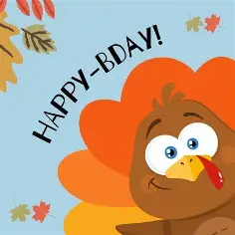



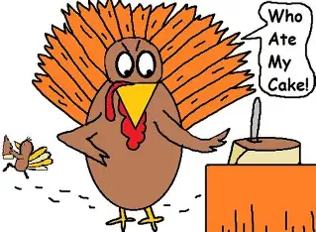
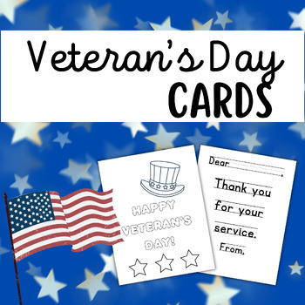


November Birthdays
1- Ed Conrath
4- Bill Stronglin
8- Carole Lainof
9- Diana Micek & Alice Gewecke
11-James Miller & Dolly Divoky
13- Barbara Shank
14- Don Muhs
15- Mary Jo Hopensperger
15 -Karen Berkland
15 -Virginia Eidenmiller
18- Laura Farmer
20- Deb Power
21 – Renate Leaird
25- Peg Dowd
27 – Clara Faulkner
29- Gary Stover & Pam Jensen
Thank you Veterans! Stop by and sign a few cards for the Veterans who are in the Bellevue Vet’s Home. Let’s get 100 cards signed for them! We have pens and cards – we just need you! Thursday, November 6th all day.
Veteran’s Day Remembrance Join us in thanking our Veterans and their families for the sacrifices they made for our freedom. Please wear you red, white and blue and let us know if you will be attending on Monday, November 10th at 11:15. Make plans to stay for lunch.
Football Fridays are still in November! Support your favorite teams by showing their team colors and shirts!

Slide 5
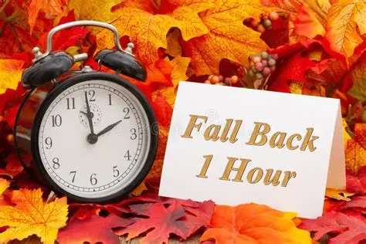



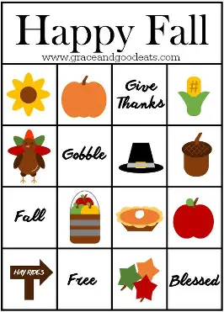
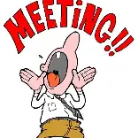




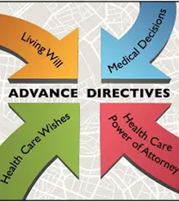

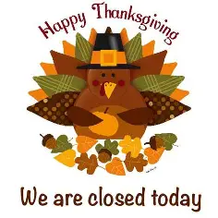


Page 5
Bellevue Senior Community Center Activities
November 2025
Monday | Tuesday | Wednesday | Thursday | Friday
8:30 Chair Volleyball 9:00 Needle Crafters 9:30 Art Class 10:15 – Tai Chi 12:30 – Hand & Foot 12:30- Poker 1:00–Mahjong | 9:30- Painting 10:00 – Exercise 12:15 -Bridge Groups 12:45- Dominoes | 9:00 – 3:00 Painting Group 10:15 – Tai Chi 12:30 – Hand & Foot | 8:00 - Woodcarvers 10:00 -Bridge Groups 12:45 Bridge Groups 12:45 Dominoes | 8:30- Chair Volleyball 9:30 – Painting 10:30 – Exercise 12:45 .25 BINGO Bridge Classes on the 1st and 3rd Fri. 10:00 Beginners 11:00 Experienced
Activities for the Month of NOVEMBER
Monday Dunkin Donuts | Tuesday | Wednesday Panera Bread | Thursday | Friday Panera Bread
SKIP-BO played daily ! |  |  |  | Every Friday is FOOTBALL FRIDAY
3 Did you ???? | 4 | 5 | 6 Cards for Veterans | 7
10 11:30 Veterans Remembrance | 11 | 12 1:00- Bingo | 13 10:30 Senior Advisory | National Pickle Day 10:30 book club
17 7:00 Meeting | 18 | 19 | 9:30 BINGO 10:30 Presentation | 21 10:30 Party
24 | 25 9:00 Hot Breakfast | 26 | 27 | 28 CLOSED

Slide 6

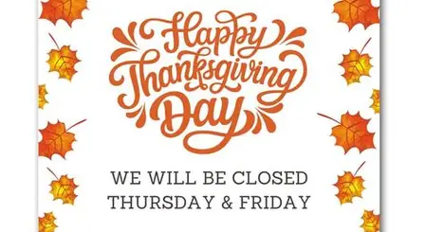
NOVEMBER HOT MENU
Monday | Tuesday | Wednesday | Thursday | Friday
11/3/2025 | 11/4/2025 | 11/5/2025 | 11/6/2025 | 11/7/2025
Oven Fried Chicken Breast | Italian Sausage in | Beef Taco Meat | BBQ Chicken Breast | Meatloaf in Tomato Gravy
Whipped Potatoes | Marinara Sauce | Shredded Cheese | on WG Hamburger Bun | Scalloped Potatoes
with Country Gravy | Peppers & Onions | Shredded Lettuce | BBQ Baked Beans | Brussels Sprouts
Diced Beets | Diced Potatoes | Pico De Gallo | Winter Blend Vegetables | WG Breadstick/Marg
Italian Dinner Roll/Marg | WG Hot Dog Bun | Chuckwagon Corn | Diced Peaches | M&M Cookie
Fudge Round | Sliced Pears | 8: Flour Tortilla Shell | 1% or Skim Milk | or Diet Cookies
or Diet Cookies | 1% or Skim Milk | Pineapple & Strawberries |  | 1% or Skim Milk
1% or Skim Milk |  | 1% or Skim Milk
Monday | Tuesday | Wednesday | Thursday | Friday
11/10/2025 | 11/11/2025 | 11/12/2025 | 11/13/2025 | 11/14/2025
WG Cheeseburger Mac | Veteran's Day | Roast Beef & Gravy | Chicken Breast with | National Pickle Day
Green Peas |  | Mashed Potatoes | Alfredo Sauce | WG Breaded Fish &
Diced Carrots |  | Zucchini & Tomatoes | Roasted Baby Red Potatoes | American Cheese Sandwich
WG Breadstick |  | WG Dinner Roll/Marg | Broccoli | Sliced Pickles
Fresh Orange |  | Decorated Birthday Cake | Hearth Roll/Marg | Mashed Potatoes
1% or Skim Milk |  | or Plain Cake Square | Sliced Peaches | WG Bun/Tartar Sauce PC
 |  | 1% or Skim Milk | 1% or Skim Milk | Ooey Gooey Cake or Applesauce
 |  |  |  | 1% or Skim Milk
Monday | Tuesday | Wednesday | Thursday | Friday
11/17/2025 | 11/18/2025 | 11/19/2025 | 11/20/2025 | 11/21/2025
Swedish Meatballs | Cheeseburger on | Sweet & Sour Chicken | Peanut Butter Fudge Day | National Stuffing Day
Baked Potato/Sour Cream | WG Hamburger Bun with | Breast | Beef Ravioli & Marinara | Baked Ham
Stewed Tomatoes | Lettuce, Sliced Tomato & | Brown Rice Pilaf | Brussels Sprouts | Cornbread Stuffing
Sour Dough Roll/Marg | Sliced Pickles | Broccoli | California Blend Veggies | Cauliflower
Strawberry Yogurt Cup | Cheesy Hashbrown | Cinnamon Raisin Bread/Marg | WG Breadstick/Marg | WG Dinner Roll/Marg
or Diet Pudding | Pineapple Tidbits | Strawberries & Mandarins | Nutty Buddy Stick | Fresh Apple
1% or Skim Milk | 1% or Skim Milk | 1% or Skim Milk | or Diet Cookie | 1% or Skim Milk
 |  |  | 1% or Skim Milk
Monday | Tuesday | Wednesday | Thursday | Friday
11/24/2025 | 11/25/2025 | 11/26/2025 | 11/27/2025 | 11/28/2025
10 Grain Fish Filet | BBQ Pulled Chicken | Turkey Breast with Gravy
Diced Sweet Potatoes | on WG Hamburger Bun | Cornbread Dressing | Day
Chuckwagon Corn | Diced Baby Red Potatoes | Whipped Potatoes
WG Dinner Roll/Marg | Green Peas | Green Bean Casserole
Sliced Peaches | Fresh Orange | Cranberry Sauce Garnish
Tartar Sauce PC | 1% or Skim Milk | WG Dinner Roll/Marg
1% or Skim Milk |  | Pumpkin Pie & Whip Topping
 |  | or Diet Pudding
 |  | 1% or Skim Milk

Slide 7
NOVEMBER DELI MENU

Slide 8
Bellevue Senior Community Center
109 W. 22nd Avenue
Bellevue, NE 68005
Over the past few years, the Bellevue Senior Community Center has experienced tremendous growth. As we continue to grow, we are always looking for new ways to improve the center. We strive to add activities and events, provide services to our area seniors, and give the seniors who attend our center a chance to get involved and give back; all the while keeping the senior center’s costs and overhead low. Continuing to grow while faced with today’s economy is not always an easy task.
Because of our growth, the Bellevue Senior Community Center has created another opportunity for seniors and others to support us, The Bellevue Senior Community Center Booster Club. The Booster Club is a 100% voluntary club that supports the efforts of the center. The cost to belong to the Booster Club is $24 per year. We pro-rate the cost if you sign up now to ONLY $2.00 a month!
Please complete an enrollment form and take it to the Front Desk at the Bellevue Senior Community Center. Your membership will be valid through June 30th, 2026

